Slide 1

Impact of Race on Preventable Deaths in the United States
Peyton Mosbaugh
Notes:
In today’s society, there are still many inequalities that put American citizens at a disadvantage due to their gender, race, ethnicity, or religion. Unfortunately, the American healthcare system is a place where those gaps occur.

Slide 2
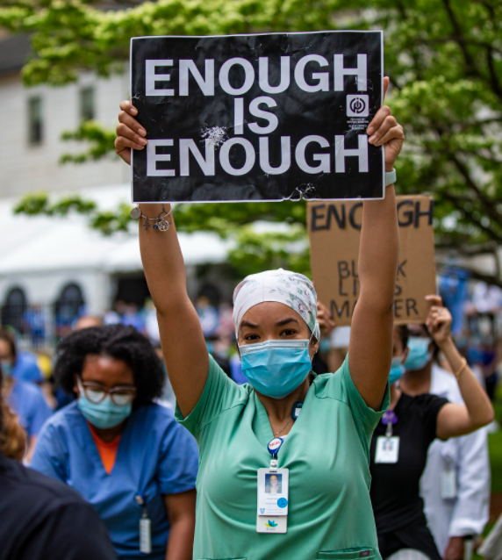
Healthcare Inequalities
Income gap
Differences in coverage
Uneven access to services
Poorer health outcomes
Notes:
Due to inequalities in the country’s healthcare system, there has been a disproportionate impact for people of color, causing gaps in health insurance coverage, uneven access to services, and poorer health outcomes. More than ninety percent of twenty-something Black Americans have their college degree yet are still paid significantly less for the same job as their White American co-workers. This income gap, of course, has its own ramifications. With healthcare being a very pricey expense for many Americans, this inequality in pay makes it harder for Black Americans to get high-quality health insurance. Although more have health insurance and longer life expectancies than several decades ago, Black Americans are still suffering from illness and deaths at much higher rates than other races in America. Although there are many different factors that play into healthcare disparities, the bottom line is that Black Americans are not receiving the same quality of care as their white counterparts. As a result of this, they are substantially more likely to die from early health issues that are at least partially treatable or preventable than White Americans.

Slide 3

Preventable Deaths
Diabetes
Heart Diseases
Flu
Cancers
STD’s
Suicide
Notes:
In fact, the preventable death rate for Black citizens is double that of White citizens. Even though recent legislature like the Affordable Care Act has given more access to affordable healthcare to uninsured Americans, the United States still have a very long way to go in reducing these health disparities. Genetics, lifestyle, and risk factors do, of course, play a large role in premature deaths. In some cases, the healthcare system just cannot simply save a person from passing unexpectedly or earlier than anticipated. However, in the case of preventable deaths, this is not necessarily the case. There is an abundant amount of screenings and testing that can be done as preventable measures in routine check-ups to catch things like diabetes, heart diseases, certain cancers, and even suicidal thoughts or depression. A lack of healthcare accessibility and coverage prevents Americans from partaking in these preventive tests. Two-thirds of the difference between Black Americans and White Americans are currently due to preventable or curable deaths. Some of these preventable deaths include: diabetes, the flu, certain cancers, infectious diseases (especially sexually-transmitted diseases), and even suicide.

Slide 4
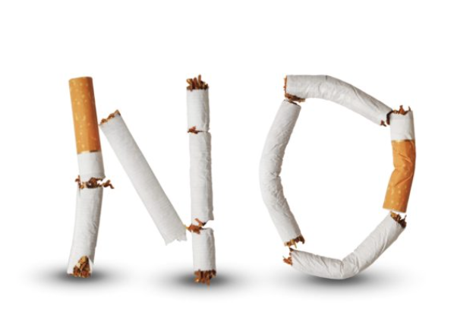
Project Objectives
Health risk factors:
Obesity
Tobacco-use
Socio-economic factors:
Unemployed
Uninsured
Notes:
The objective of this project is to look into potential risk factors such as obesity and tobacco-use to see if the number of people putting themselves at a heightened risk differs between the two races. Differences in socio-economic factors such as being uninsured or unemployed is also examined between the two groups. The number of deaths that could have been prevented is also analyzed to see if indeed there is a gap between Black Americans and White Americans. The goal is to use data to potentially highlight these disparities; and as a result, possibly the data can be used to push forward policy changes that could help to eliminate the racial gap in America’s healthcare system.

Slide 5
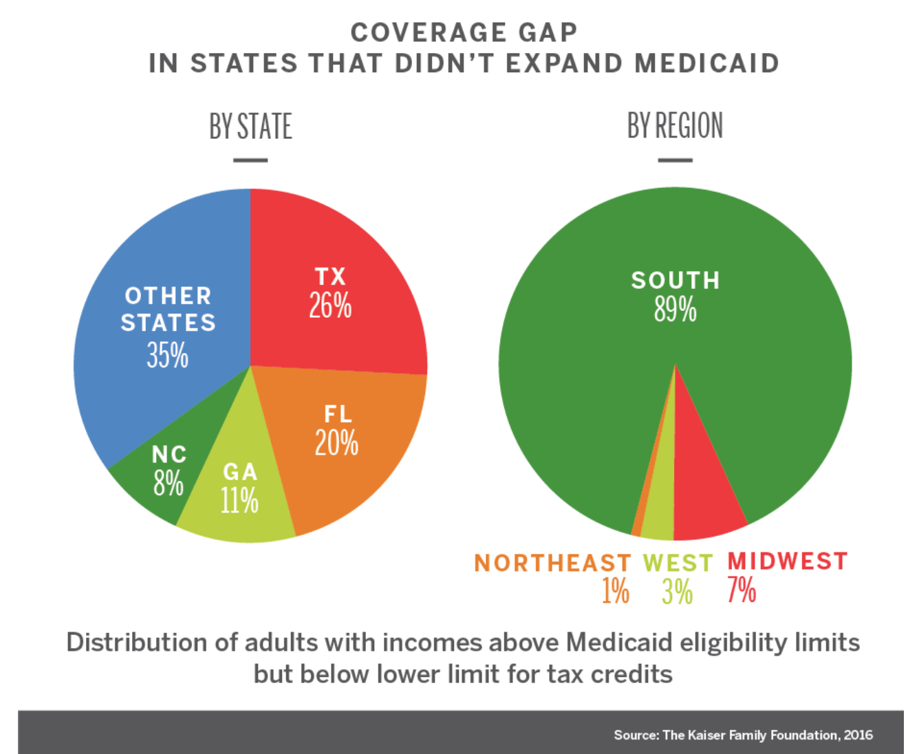
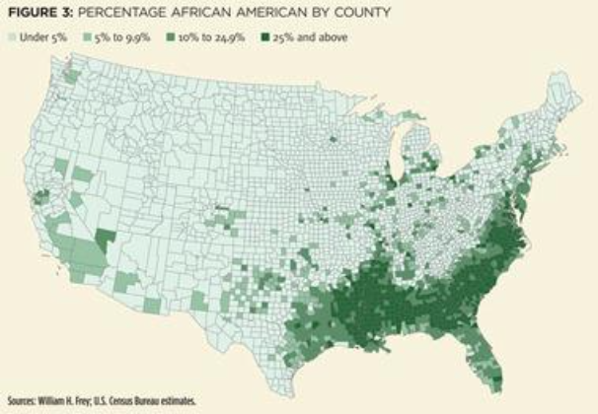
Legislative Understanding
Notes:
the Affordable Care Act has been a tremendous push in the right direction in terms of making healthcare more accessible and affordable to those who need it. To dive deeper in an understanding of the Affordable Care Act, or ACA, specifically, it allows states to decide whether or not they want to opt into a Medicaid expansion. Although this sounds like a win in helping get care for citizens, twelve states have still not passed or opted into this Medicaid expansion: Wyoming, Texas, South Dakota, Wisconsin, Mississippi, Tennessee, Alabama, Georgia, North Carolina, South Carolina, Kansas, and Florida. A handful of these states are located in the South, that has a higher proportion of Black Americans than the national average. If these states decided to pass the Medicaid expansion that is a part of the ACA, then this would be a big push in helping the racial disparities in healthcare. The business goal of this project is to find data that highlights the disparities to show these states that the ACA could help save lives, especially Black Americans.

Slide 6


Data Understanding
Risk Factors:
Obesity, tobacco-use
Uninsured, unemployed
Preventable Deaths:
Diabetes -- Flu
Cancer -- Homicide
HIV -- Suicide
Heart Disease
Notes:
In order to perform this analysis, the proper data was needed. Data from the CDC was used for the project, since they have very up-to-date and accurate numbers being the nation’s health protection agency. In addition, datasets for unemployment were found from the United States Bureau of Labor. The timeframe for the datasets is 2005-2017. Risk factors such as obesity and tobacco use were looked at, as these could be causes for preventable deaths that people often bring upon themselves and put themselves at a higher risk. Socio-economic factors of being uninsured and unemployed also were looked at, as these impact a person’s ability to get healthcare and preventative screenings. Then, of course, the statistics on the number of deaths due to the preventable causes of diabetes, cancer, HIV, heart disease, flu, homicide, and suicide for both races were also found.

Slide 7
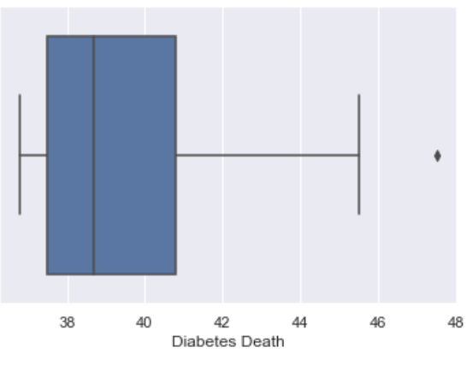
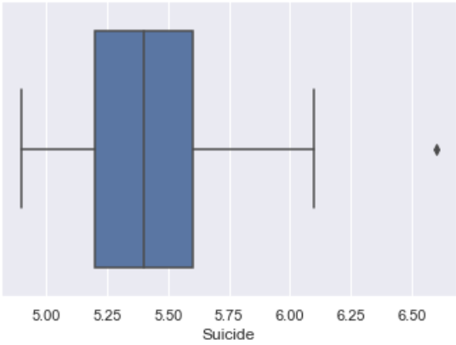
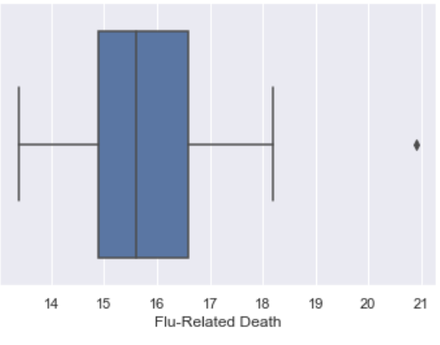
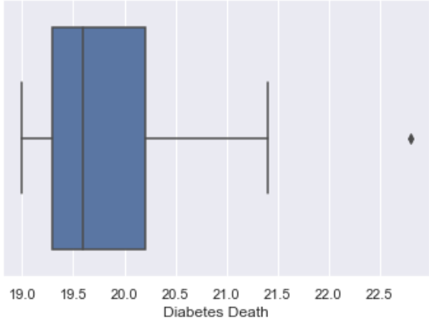
Data Analysis
Black American Data
White American Data
Notes:
First, boxplots were created for each variable to find any outliers. Two outliers were found for the Black American data, diabetes and suicide as well as two for white American data, flu-related deaths and diabetes. Because the outliers did not line up between the two datasets, the outliers were left unchanged in the data. One of the main purposes for this project was comparing the data between the two races over time, and if the outliers were removed or changed, the task would be quite difficult.

Slide 8
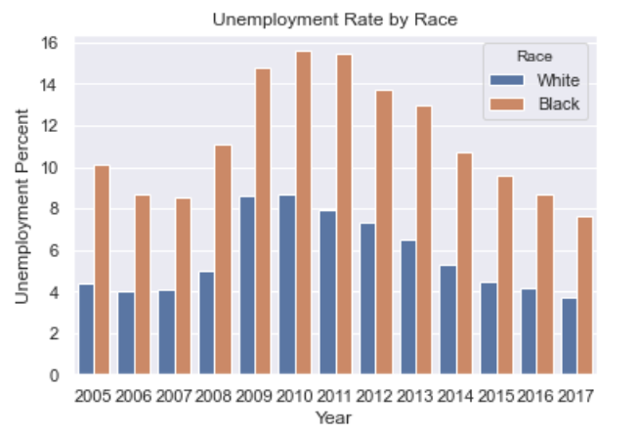
Data Analysis-Unemployment
Notes:
Next, histograms were created for each variable to compare the data between the two races. For unemployment, the percentage of unemployed Black Americans is significantly higher than that for White Americans from 2005 to 2017. On average, the percent of unemployed Black Americans is close to double the percent of unemployed White Americans as seen in the figure displayed.

Slide 9
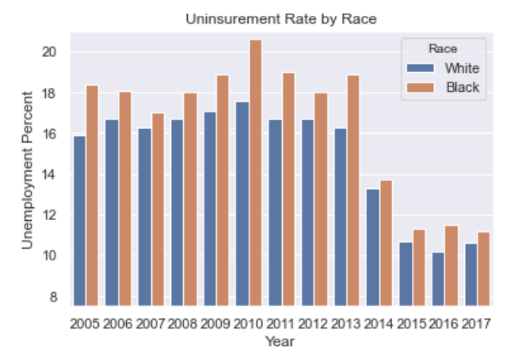
Data Analysis-Uninsured
Notes:
The percent of uninsured Black Americans over the years was also higher than the percent of uninsured White Americans. Although the differences in the percentages was not as drastic as that of unemployment, there is still a consistent difference over these thirteen years. This histogram shows that difference.

Slide 10
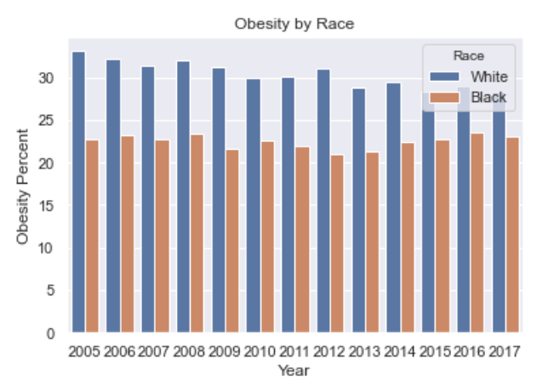
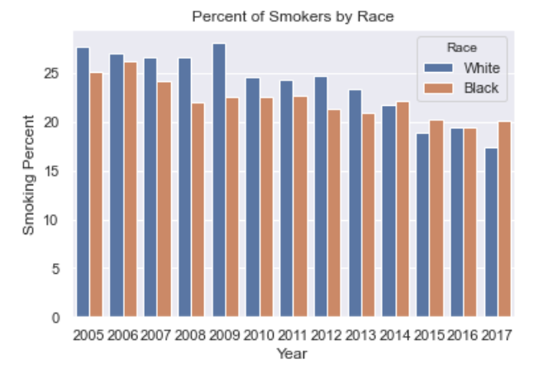
Data Analysis- Obesity and Tobacco-Use
Notes:
Looking into the risk factors of obesity and tobacco-use are very important because these are two somewhat “controllable” factors that people can be aware of to lower their risk of diseases. Obviously, this is not the case and not controllable for all people, but generally speaking. The health risk factors had much different results than the socio-economic factors. In terms of tobacco-users, the percentage of smoking White Americans was higher than that of Black Americans from 2005-2013. From 2014-2017, the percentage of smoking Black Americans was slightly higher or about the same as the percent of White Americans who use tobacco. Five to ten percent more of White Americans were obese from 2005-2017 than Black Americans. Obesity in white citizens was consistently much higher. Based on this, it can be seen that Black Americans were at a higher risk of preventable deaths due to socio-economic factors, but White Americans were at a higher risk because of health factors.

Slide 11
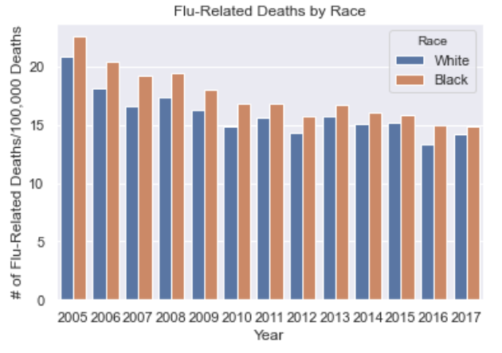
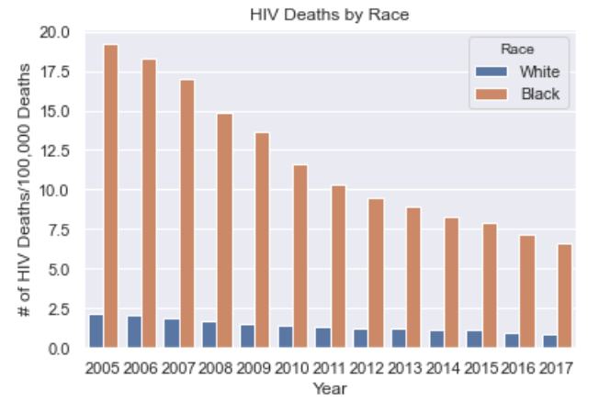
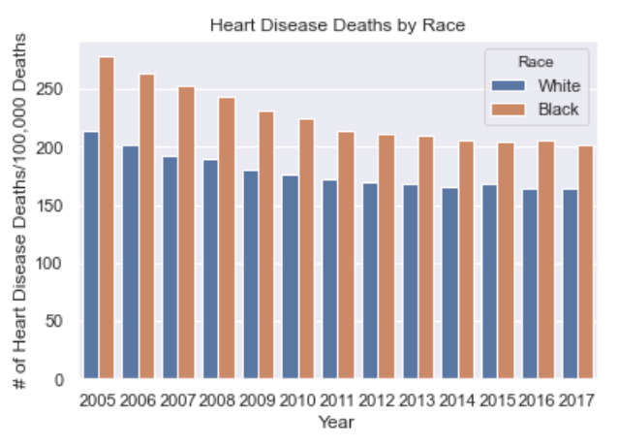
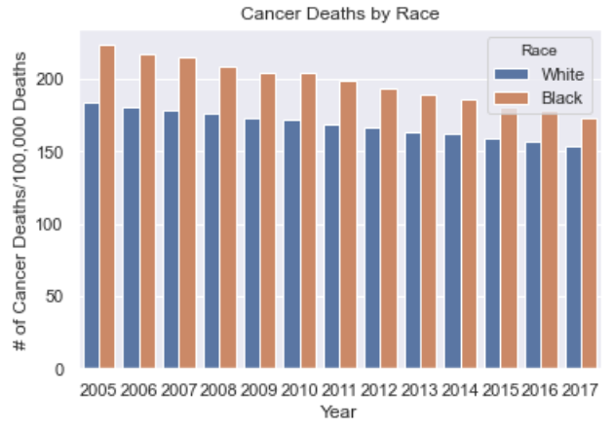
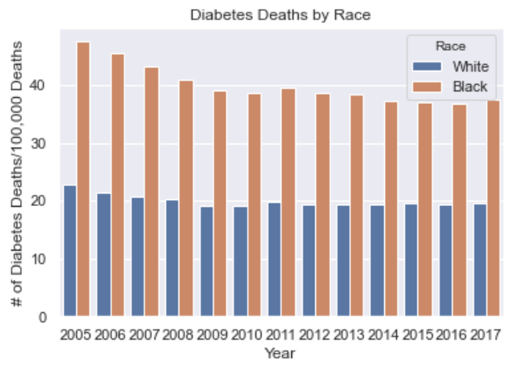
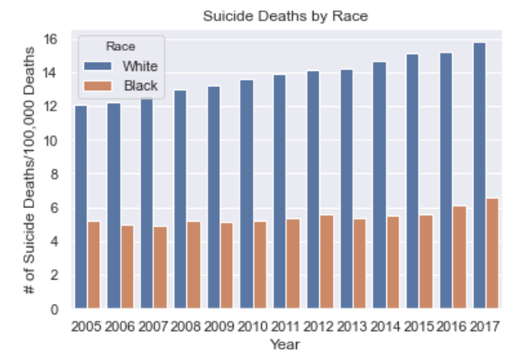
Data Analysis-Preventable Deaths
Notes:
All of the preventable death data was represented in the number of deaths per 100,000 deaths. The histograms comparing death rates for HIV, flu-related, cancer, heart disease, and diabetes all showed very similar trends in that more Black American deaths were due to these preventable deaths than those of White Americans. This was the case for each year included in this project. In terms of diabetes deaths, Black American deaths were almost twice as high as those of White American deaths due to this health condition. Deaths due to homicide followed a similar trend, but was nearly four times higher for Black Americans than White Americans. Deaths from suicide was the only preventable death that was higher for White Americans and was close to three times higher than for Black Americans.

Slide 12
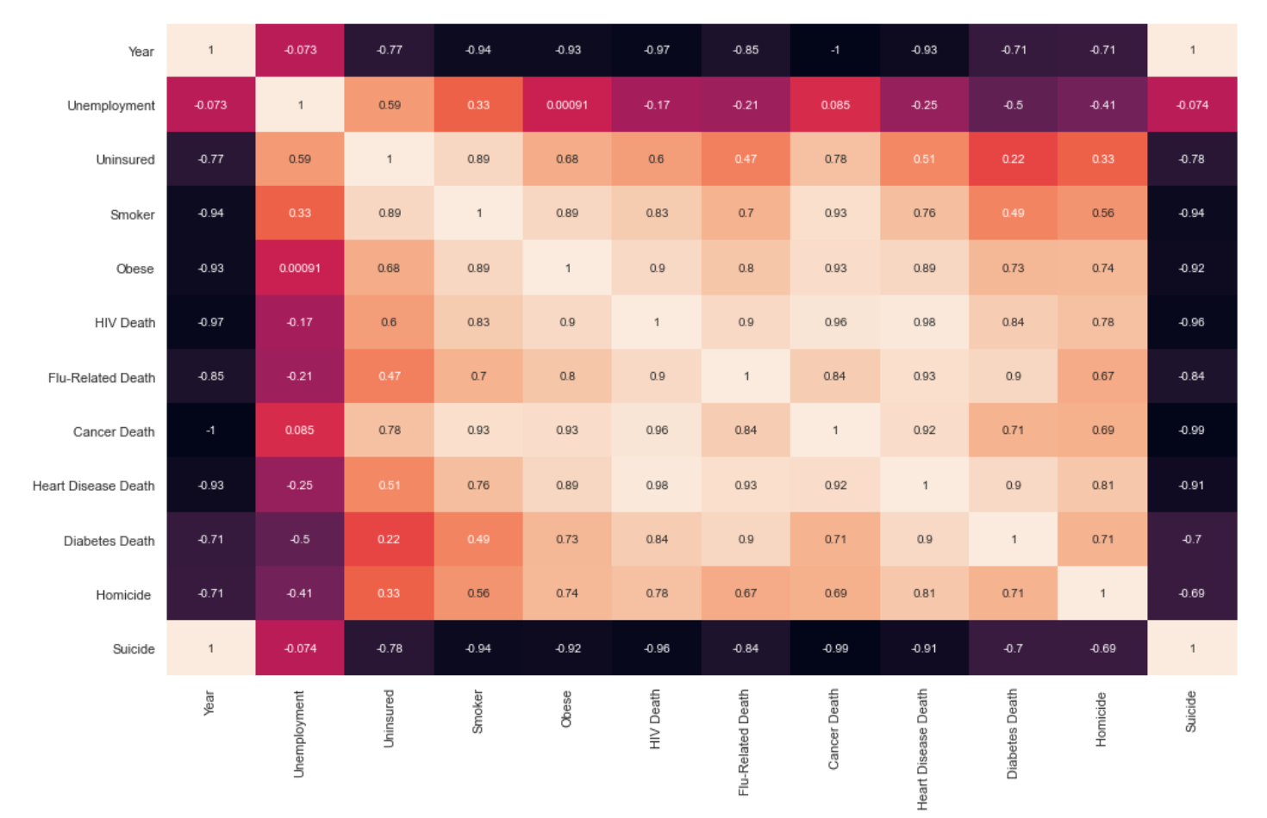
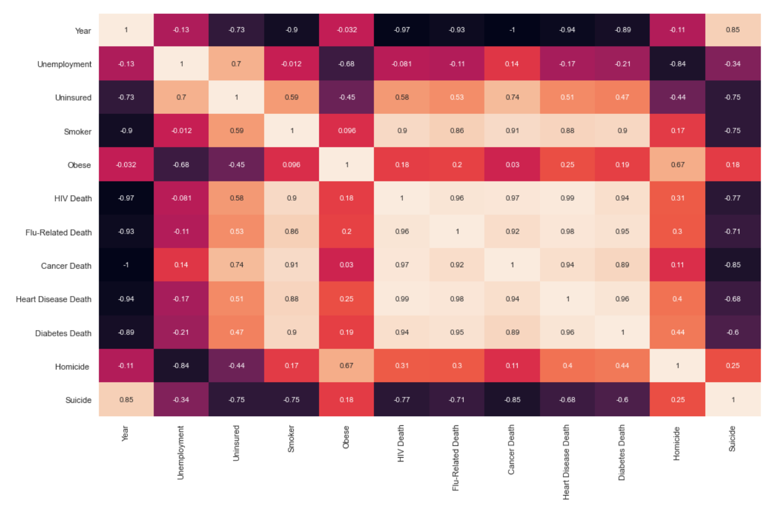
Correlations between Risk Factors and Deaths
Notes:
A correlation matrix was created for each race in order to further the understanding of which risk factors are correlated to preventable deaths. For each matrix, the correlations between health risk factors of obesity and tobacco-use and the preventable deaths as well as socio-economic factors of being uninsured and unemployed and the preventable deaths. The correlation between White uninsured Americans and White Americans deaths due to cancer, with a correlation coefficient of 0.78, was very strong. A similar strong correlation was seen with Black Americans and a correlation coefficient of 0.74. There was also a very strong correlation between White Americans who used tobacco and those who were uninsured, with a coefficient of 0.89. Surprisingly, unemployment did not show any strong correlations with any other variable from either dataset. The percentage of White American tobacco-users was highly correlated to cancer (0.93) and HIV deaths (0.83), as well as being obese (0.89). For Black Americans, the correlation of tobacco users was highly correlated to diabetes (0.90), heart disease (0.88), cancer (0.91), flu-related (0.80), and HIV deaths (0.90). There were several more strong correlations for Black tobacco-users than White. Although obesity in Black Americans did not have any strong correlations within the dataset, this was not the case for obese White Americans, which had a correlation coefficient of 0.89 with heart disease deaths, 0.93 with cancer deaths, 0.93 with flu deaths, and 0.9 with HIV deaths.

Slide 13
Analysis of Findings
Health Risk Factors:
White Americans at heightened risk
Socio-economic Risk Factors:
Black Americans at heightened risk
Preventable Deaths by Physical Health Conditions:
Black Americans more at risk
Preventable Deaths by Mental Health Condition:
White Americans more at risk
Notes:
One surprising aspect of the findings was that there were higher percentages of White Americans who put themselves at a heightened risk by smoking or being obese, yet they had less deaths from the preventable conditions, aside from suicide, than Black Americans. Based on the background, it is known that being obese and being a smoker drastically increase a person’s risk of developing most of these conditions and dying from them, especially since these two factors weaken a person’s immune system. With this knowledge and seeing that these two factors dramatically increase risk of disease, it shows that there has to be another factor playing into why more Black Americans are dying despite being less obese and smoking less. It was also expected that more Black Americans would be unemployed and uninsured than White Americans, since so much of the background for this project touched on this issue. Although there was a consistent difference in the percentage of Black Americans uninsured compared to White Americans, the difference on average was within two percent. Considering how strong the trend is of Black Americans dying from these preventable diseases and the fact that they smoke less and are less obese, one would think that this divide in healthcare coverage would be greater.

Slide 14

Future Steps
Notes:
Moving forward in order to further explain this difference, the quality of the health care and health insurance should be looked at. Because unemployment differs so greatly between the two races, it could be impacting the quality and coverage of health insurance that they are able to afford. Going along with this, having high deductibles with insurance can also prevent someone from going to receive preventative screenings and tests since most of it would most likely have to be paid out of pocket. Since there is a great divide in unemployment between the two races, this might be a way to dive deeper and further explain why there is this racial inequality in today’s healthcare and how more affordable health insurance and health care could aid in fixing it and saving lives.

Slide 15
References
Bureau, U. (2020, September 16). Income, Poverty and Health Insurance Coverage in the United States. Retrieved December 06, 2020, from https://www.census.gov/newsroom/press-releases/2020/income-poverty.html
Byrnes, H. (2020, May 07). This is the racial divide among cancer deaths in every state. Retrieved December 06, 2020, from https://www.usatoday.com/story/money/2020/05/07/the-racial-divide-in-cancer-deaths-in-every-state-and-dc/111637122/
Goldman, D. (2020, November 16). Obesity, second to smoking as the most preventable cause of US deaths, needs new approaches. Retrieved December 06, 2020, from https://theconversation.com/obesity-second-to-smoking-as-the-most-preventable-cause-of-us-deaths-needs-new-approaches-129317
Homepage - Health, United States - Products. (2019, October 30). Retrieved December 18, 2020, from https://www.cdc.gov/nchs/hus/index.htm
Maxwell, C., & Carratala, S. (2020). Health Disparities by Race and Ethnicity. Retrieved December 06, 2020, from https://www.americanprogress.org/issues/race/reports/2020/05/07/484742/health-disparities-race-ethnicity/
Radley, D. (2019, August 06). Diving into the Data: How Many Americans Die Prematurely from Treatable Causes? Retrieved December 06, 2020, from https://www.commonwealthfund.org/blog/2019/americans-die-prematurely-treatable-causes
STDs Continue to Rise in the U.S. Press Release. (2019, October 08). Retrieved December 06, 2020, from https://www.cdc.gov/nchhstp/newsroom/2019/2018-STD-surveillance-report-press-release.html
Unemployment Rate by Race. (n.d.). Retrieved December 18, 2020, from https://www.macrotrends.net/2508/unemployment-rate-by-race
Vital Signs: Preventable Deaths from Heart Disease and Stroke|DHDSP|CDC. (2019, March 13). Retrieved December 06, 2020, from https://www.cdc.gov/dhdsp/vital_signs.htm
Young, C. L. (2020, February 20). There are clear, race-based inequalities in health insurance and health outcomes. Retrieved December 06, 2020, from https://www.brookings.edu/blog/usc-brookings-schaeffer-on-health-policy/2020/02/19/there-are-clear-race-based-inequalities-in-health-insurance-and-health-outcomes/
Notes:
Thank you for your time. I will now be taking any questions on today’s presentation and the project that was discussed.

